Slide 1
Mind Your Stack Fingerprinting Self-Hosted Software Through Passive Network Observation
By Jisnu Gujjalapudi Madhusudan and Ryan Walker Clarson
CS 578 Cybersecurity | March 11, 2026
College of EECS
Oregon State University

Slide 2

Roadmap
1
Research Question
2
Methodology
3
Scope
4
Finding 1
5
Finding 2
6
Finding 3
7
Conclusion

Slide 3
Research Question & Threat Model
Is it possible for a passive adversary to fingerprint container software deployments by observing network traffic?
Yes! Each of the three applications we studied has a distinctive periodic pattern.
Passive observer
ISP or network provider
Enterprise or campus admin
On-path observer
Observes traffic, does not modify it
What they see
DNS queries (domain lookups)
TLS SNI (domain in handshake)
Connection timing and frequency
NOT encrypted payload content
What we do NOT claim
Not all self-hosted apps
Not an ecosystem survey
Not a trained classifier
Evidence for possibility in 3 apps

Slide 4
Methodology
Three applications
n8n: workflow automation
Immich: photo management
Nextcloud: file sync and sharing
Different architecture, different telemetry
Two deployment modes
Isolated image: docker run (DockerGym-style)
Full stack: Docker Compose with DB + cache
Does the stack change observable behavior?
Lifecycle phases
Boot: 5 min (pre-consent traffic)
Idle: 60 min (background heartbeats)
Interaction: 10 min (user-triggered)
Extended: 72-hour continuous capture.
Instrumentation
CoreDNS at 172.30.0.2 for DNS logging
tcpdump on Docker bridge interfaces
tshark for TLS SNI extraction
Playwright for automated browser interaction
Four evidence datasets
DockerGym baseline (2-min isolated)
Automated stack runs (65-min lifecycle)
72-hour manual capture (periodic patterns)
Opt-out reruns (remediation test)
Authoritative metric: TLS SNI
Domain name visible in TLS handshake
Per-experiment pcap (no cross-contamination)
DNS logs accumulate, so supportive only
All domain claims based on TLS SNI

Slide 5
Scope & Limitations
3-app case study
n8n, Immich, and Nextcloud. We cannot claim all self-hosted software is fingerprintable
3
Applications studied
Single server environment
All experiments ran on one Ubuntu server. Environmental factors could differ elsewhere.
Metadata only
We observed DNS, TLS SNI, and timing. No payload inspection, no Man-In-The-Middle (MITM), no TLS interception
3 mechanisms
1 environment
Each app shows a different mechanism
n8n: timing gap
Immich: crash/dependency gap
Nextcloud: boot-phase gap.

Slide 6
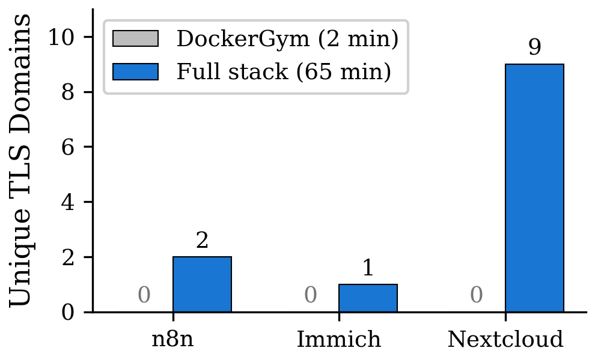
Finding 1: Short Isolated Runs Miss Real Behavior
Key result
DockerGym baseline: 0 TLS SNI domains
Automated full-stack: 12 TLS SNI domains
100% of destinations missed in 2-min runs
Why the gap appears
n8n: Telemetry callback fires after 2 mins
Immich: solo images crash without DB
Nextcloud: needs DB initialization before external calls
DockerGym baseline vs automated full-stack comparison

Slide 7
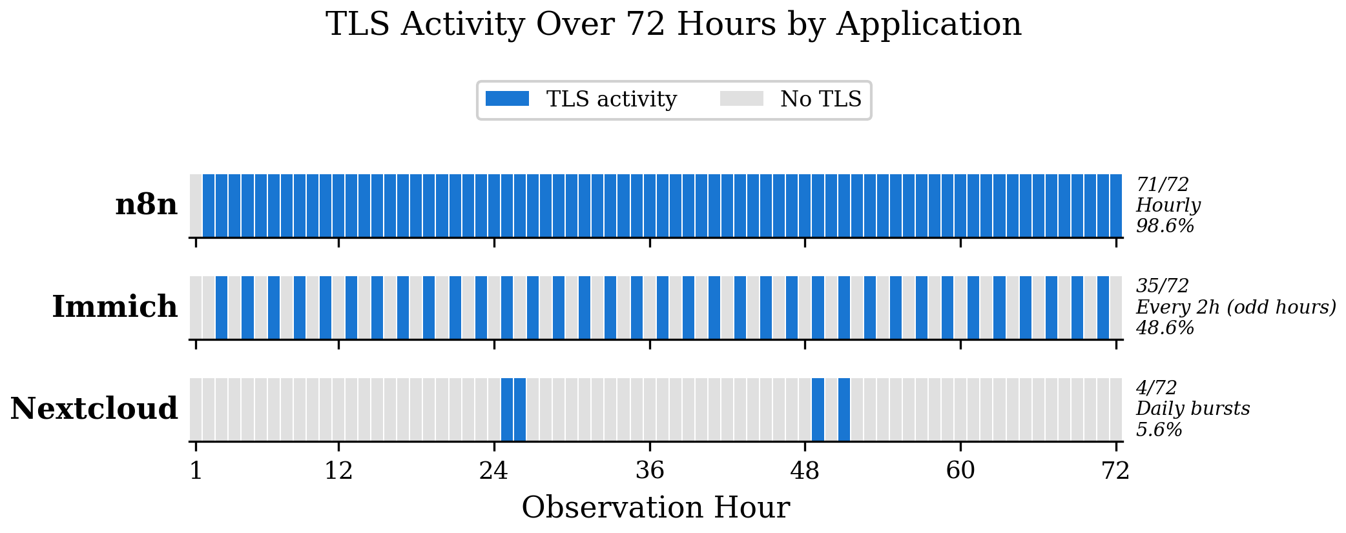
Finding 2: Periodic Traffic Enables Fingerprinting
n8n: 71/72 hours
Hourly telemetry (PostHog + n8n)
1-hour fingerprint window
Immich: 35/72 hours
api.github.com – every 2h (odd hours)
4-hour fingerprint window
Nextcloud: 4/72 hours
Coarse daily recurrence
24-hour fingerprint window

Slide 8
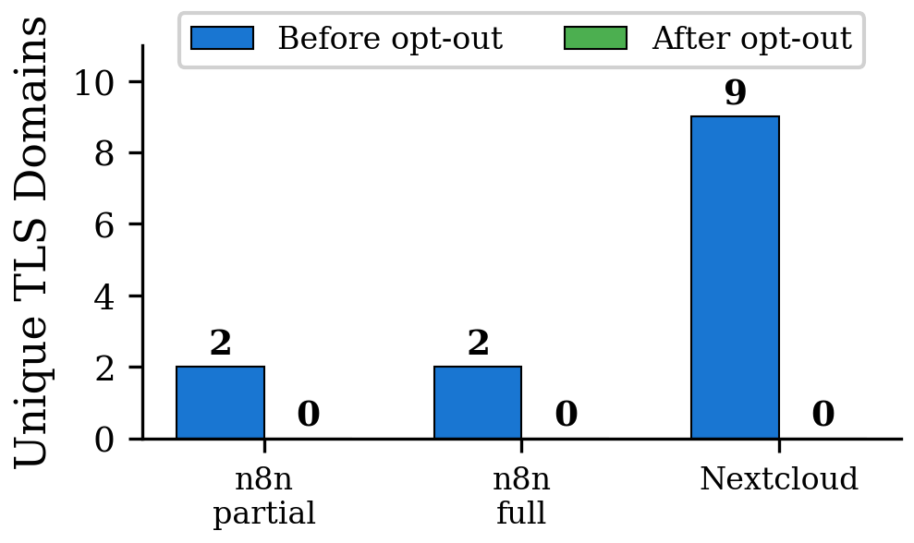
Finding 3: Opt-Out Controls Work
Result
n8n partial opt-out: 2 → 0 domains
n8n full opt-out: 2 → 0 domains
Nextcloud opt-out: 9 → 0 domains
100% reduction across all configurations
Interpretation
The privacy risk is not inevitable
Vendor-provided controls work when configured correctly
Caveat
These controls are not enabled by default.
Users must discover and configure them

Slide 9
Conclusion
Takeaway 1
Passive fingerprinting was possible for all 3 apps using network metadata alone.
What a passive adversary learns
What software is deployed (app identity)
When telemetry recurs (timing signature)
Whether remediation is enabled (opt-out state)
Takeaway 2
Short isolated runs missed behaviors that matter for privacy and fingerprinting
Takeaway 3
Extended observation reveals distinctive periodic patterns in all three applications.
Scoped claim
Evidence for possibility, not ecosystem-wide prevalence.
Each app exhibited a different mechanism.
Takeaway 4
Opt-out controls suppress telemetry when configured, but are not enabled by default.
Self-Hosting reduces data exposure but also does not eliminate network-visible fingerprints by default.

Slide 10

References
[1] "Uncontained Danger: Quantifying Remote Dependencies in Containerized Applications," RAID 2025 (DockerGym). [Primary Comparison]
[2] T. Hu et al., "Measuring Smart Home IoT Behavior Using Network-Inferred Behavior Models," IMC 2023 (BehavIoT).
[3] J. Varmarken et al., "Fingerprinting Smart TV Apps," PoPETS 2022 (FingerprinTV).
[4] Cherubin et al., "Online Website Fingerprinting: Evaluating Website Fingerprinting Attacks on Tor," USENIX Security 2022.
Project Repository
github.com/ZEUSGMJ/mind-your-stack

Slide 11
Disclosure
This project used Claude (Anthropic) for assistance with shell script development, crash diagnosis, and research outlining.
Gemini Deep Research assisted with literature survey.

Slide 12
Questions

Slide 13
Thank You

